Slide 1
Motion Estimator
Karuna RC (915880893)
Premdeep Amudala (913773112)

Slide 2
Requirements
16x16 Reference Block
31x31 Search Window
Search memory is two-read-ported memory
One memory per search
Grey-scale coded pixels (8 bits/block)
4096 reference blocks in a frame
Timing requirements:
search speed at 15 frames per second
Encoding is not in real time
Clock: 260 MHz
Target Library: 90 nm CMOS library (standard max db)

Slide 3
Design
Top Down Design
4096 blocks per 1/15 of a second
(31-15)x(31-15)=256 searches/block
16x16=256 add-accumulates per search
At 260 MHz At least 16 adders in parallel (4027/260=15.5)

Slide 4
Elements in the Design
Processing Elements (PEs)
Controller
Comparator
Top Module

Slide 5
Project Deliverables
Bug Free RTL
Unit level testing
Full-chip testing
System Verilog test bench for random stimulus based verification
Verified for 1000 iterations
Synthesis
Clock: 260MHz
Input and Output Delays: Set at Zero
Min Area, Min Power
Place and Route
Chip Layout
Chip Area
Chip Power
Post-Layout Primetime
Positive Slack on: Hold and Setup timings

Slide 6
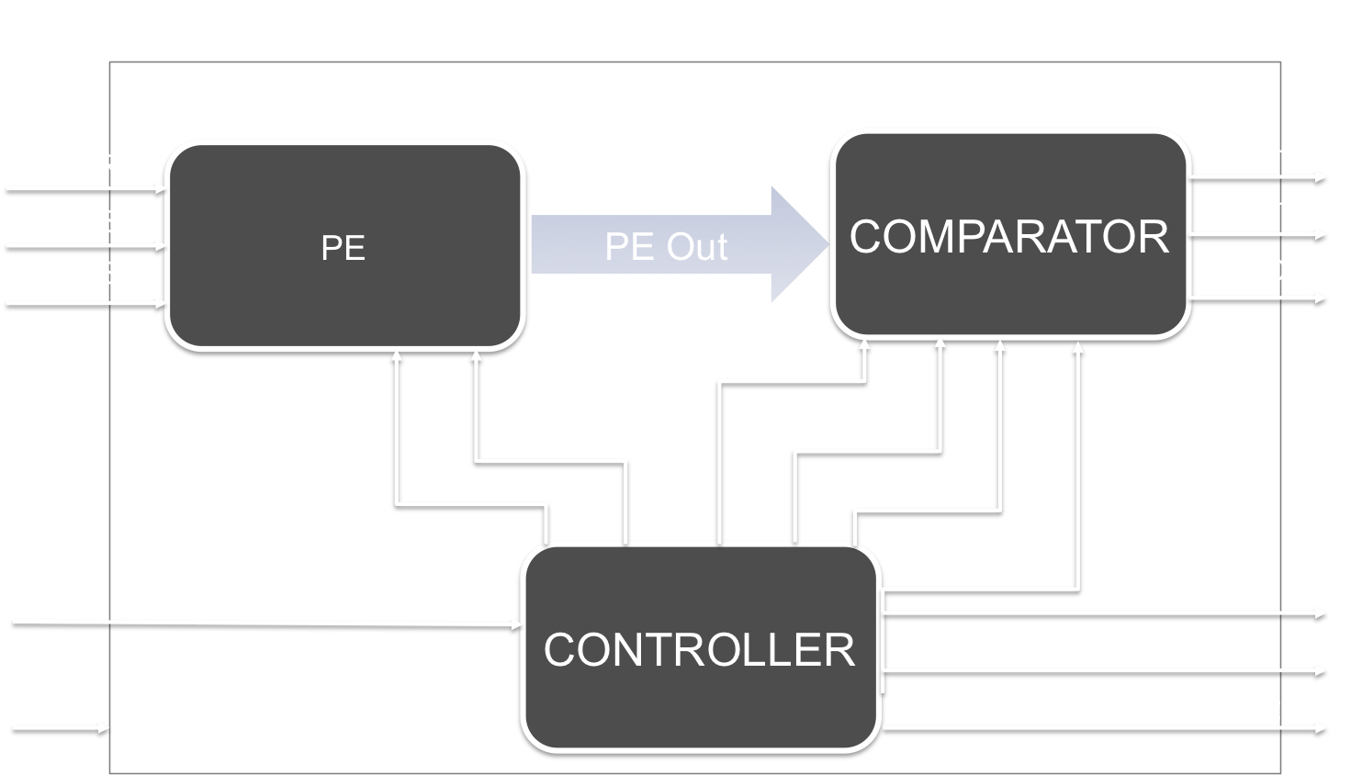

Slide 7
Processing Element: Bugs
Race Condition elimination due to temporary assignment to accumulator and registering this data to accumulate_out at clock
Computed absolute value, by using carry flag to identify the negative number

Slide 8
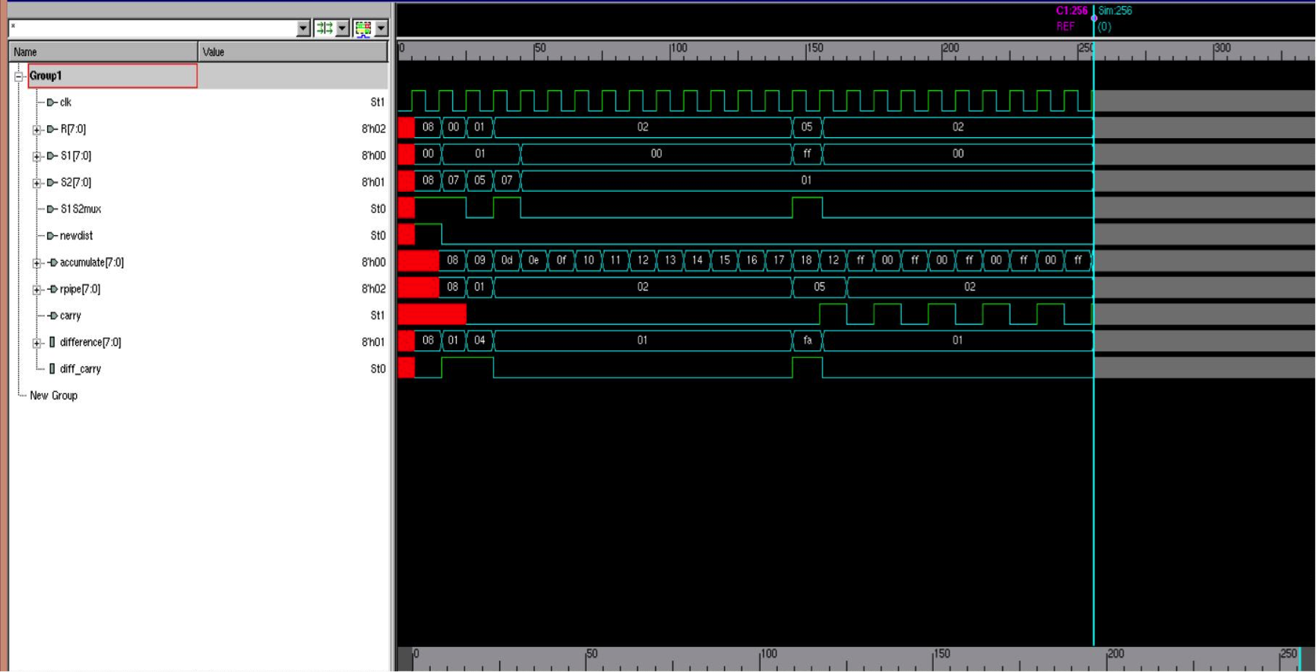
PE Waveform

Slide 9
Controller
Address generation logic
Bugs Fixed
Address generation logic for search memory S2
Compstart logic
MotionY generation logic

Slide 10
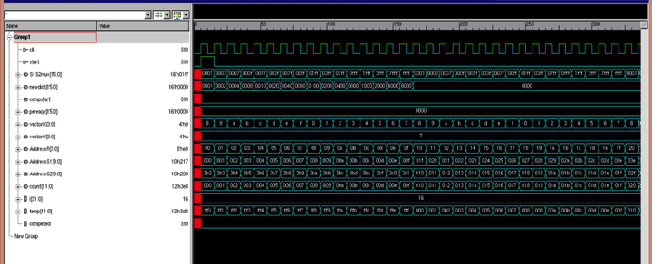
Controller: Waveform

Slide 11
Comparator: Bugs
Compstart logic
One hot encoding based PE data selection

Slide 12
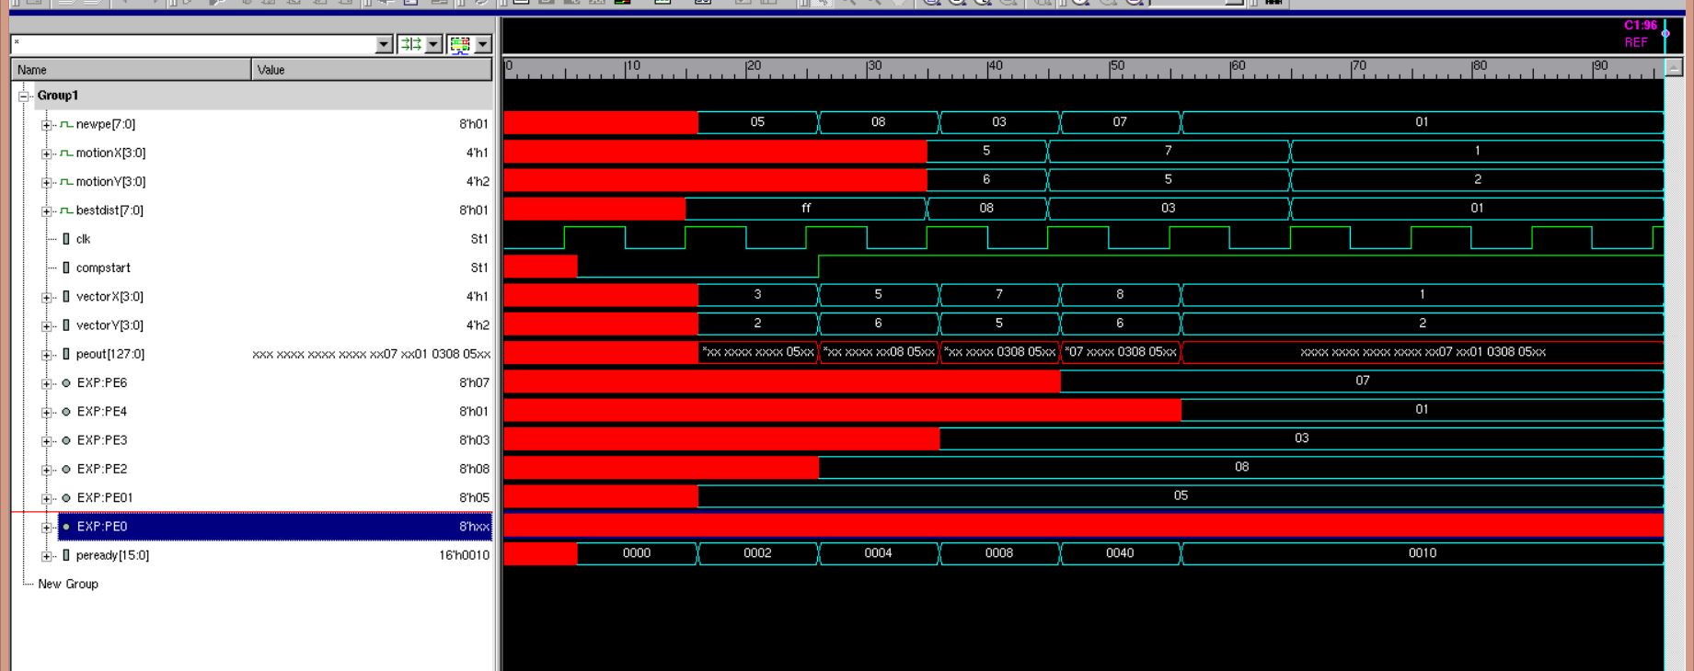
Comparator: Waveform

Slide 13
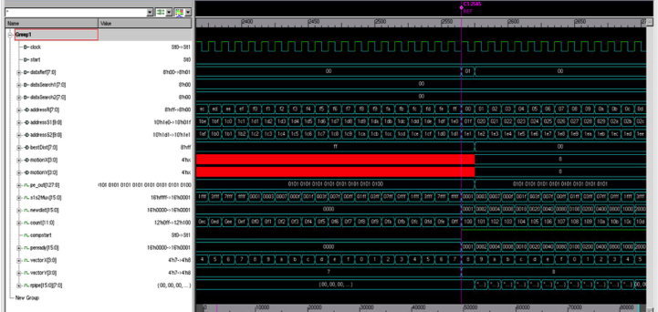
Full Chip Test bench: Waveform

Slide 14
System Verilog Test Bench

Slide 15
Design
Memory
Distortion and Vector Generator
Scoreboard
Results
Memory Driver
DUT
Checker
Clock and Start

Slide 16
Test Flow
Memory Creation
Data Randomization
Distortions and Vector Generation
Spawn Threads
Assert Start
Memory Driver
Checker
Counter
Wait for Sync (all Threads to complete)
Finish

Slide 17
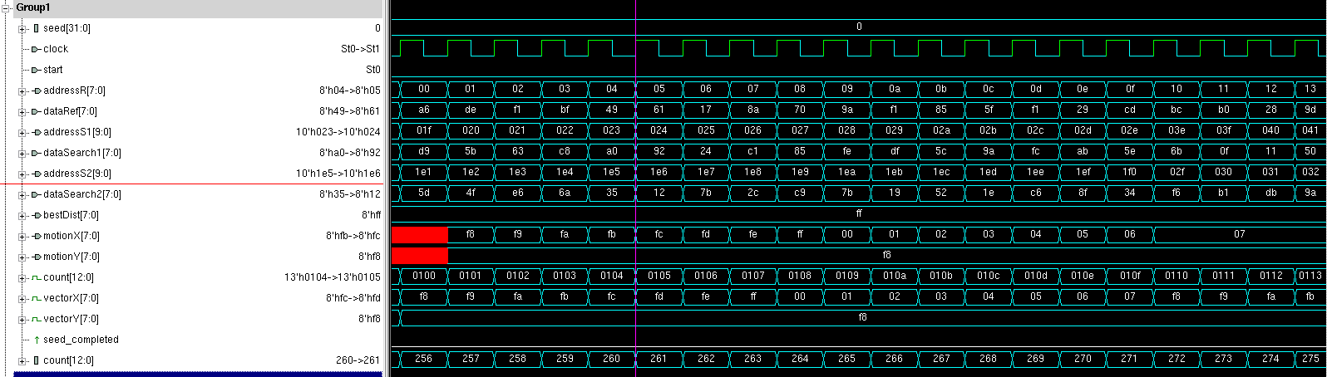
Wave dump: Single seed

Slide 18
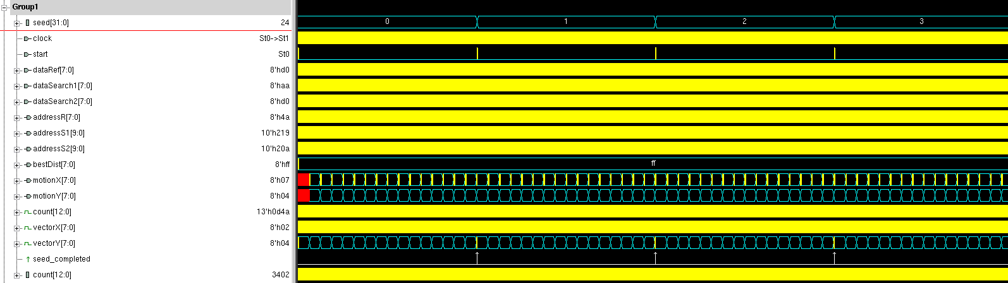
Wave dump: Multiple seeds

Slide 19
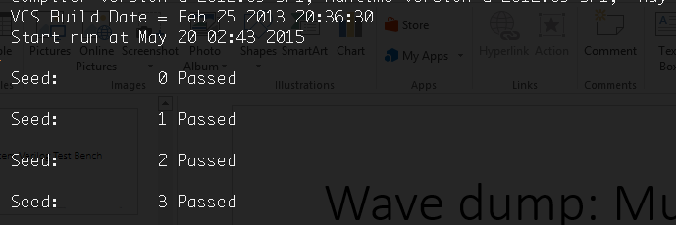
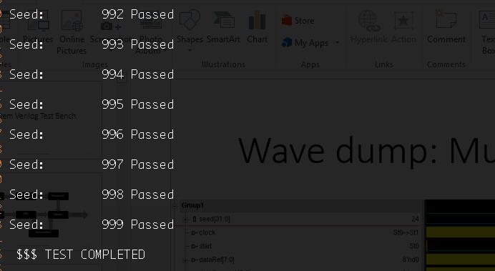
1000 Seeds: Passed

Slide 20
Enhancements
Performance
Current enhancement of implementation of shift register to realize multiplication operations.
Eliminating Race Conditions
Power Management
Clock Gating of PE when the distortion reaches max value of FF
Stopping the search when perfect match is found

Slide 21
Physical Design

Slide 22
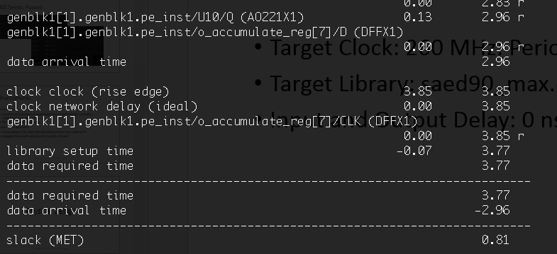
Synthesis
Target Clock: 260 MHz: Period: 3.846 ns
Target Library: saed90_max.db
Input and Output Delay: 0 ns

Slide 23
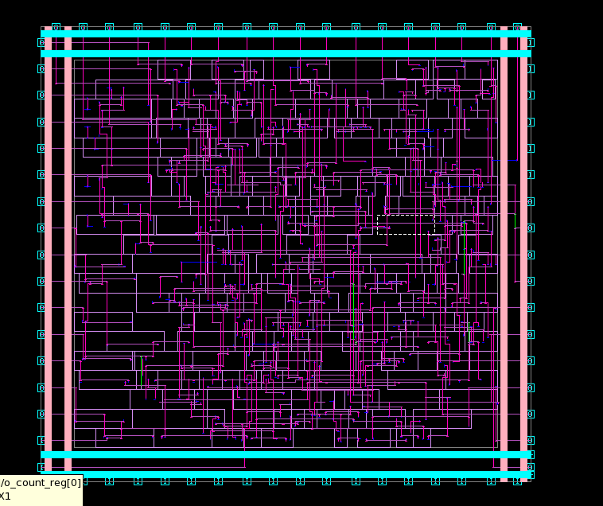
Place and Route
Target Library: saed90_max.db
Clock: 3.864ns

Slide 24
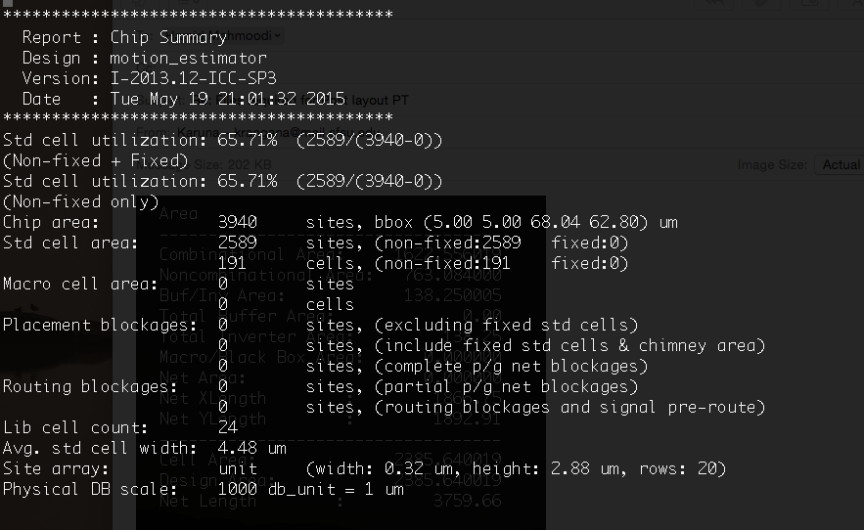
Place and Route: Results
Chip Area: 3940 Sites

Slide 25
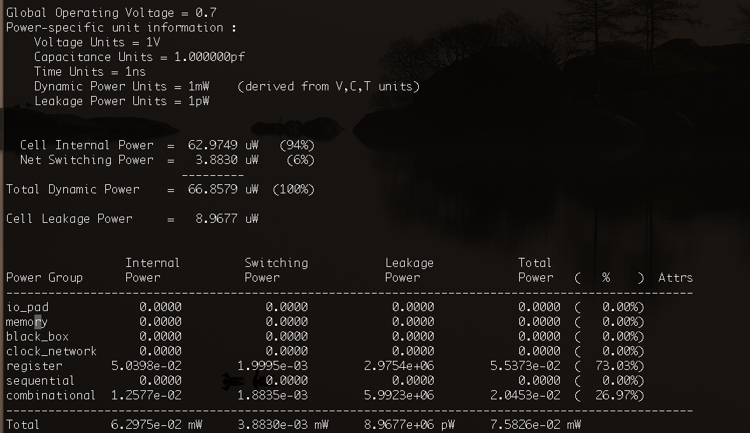
Place and Route: Results: Cont’d
Chip Power: 66.8759 uW
Leakage: 8.9677 uW

Slide 26
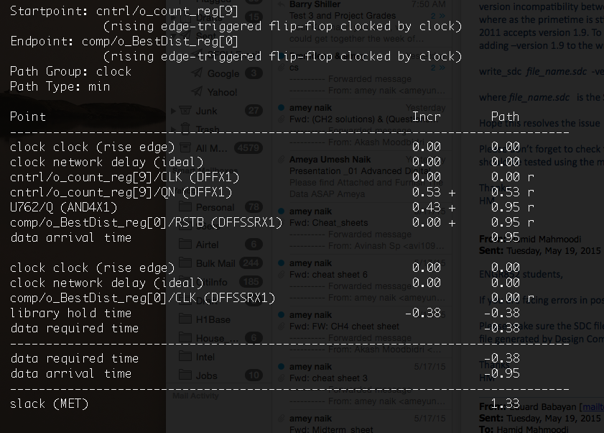
Post Layout: Timing reports
Hold Timing (Min): 1.33

Slide 27
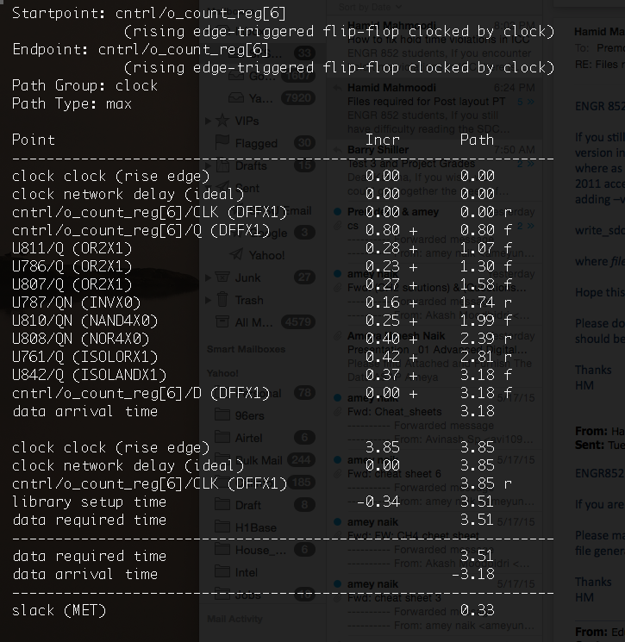
Post Layout: Timing reports
Setup Timing (Max): 0.33

Slide 28
Project Deliverables: Achieved
Bug Free RTL - Done
Unit level testing
Full-chip testing
System Verilog test bench for random stimulus based verification - Done
Verified for 1000 iterations
Synthesis - Done
Clock: 260MHz (3.846ns) – MET: 0.81
Input and Output Delays: Set at Zero
Min Area, Min Power
Place and Route
Chip Layout - Done
Chip Area: Done: 3940 Sites
Chip Power: Done: 66.8759 uW
Post-Layout Primetime
Positive Slack on: Hold and Setup timings: MET (Hold: 1.33, Setup: 0.33)

Slide 29
Thank you

Slide 30
Block Diagram
Motion Estimator
Processing Unit
(16 PEs)
Comparator
Best Distortion and
Motion (x,y)
Data
Output
Controller
Clk / Start
Addr

